Slide 1
Weekly Report 10/30
Christina

Slide 2
Outline
Monte-Carlo iteration #1 (finished)
Trip to Hawaii

Slide 3
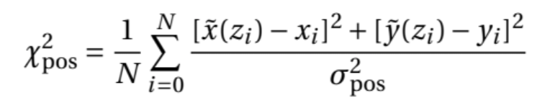
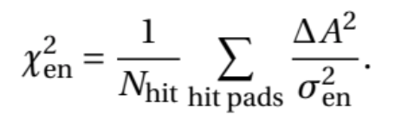
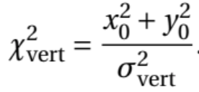
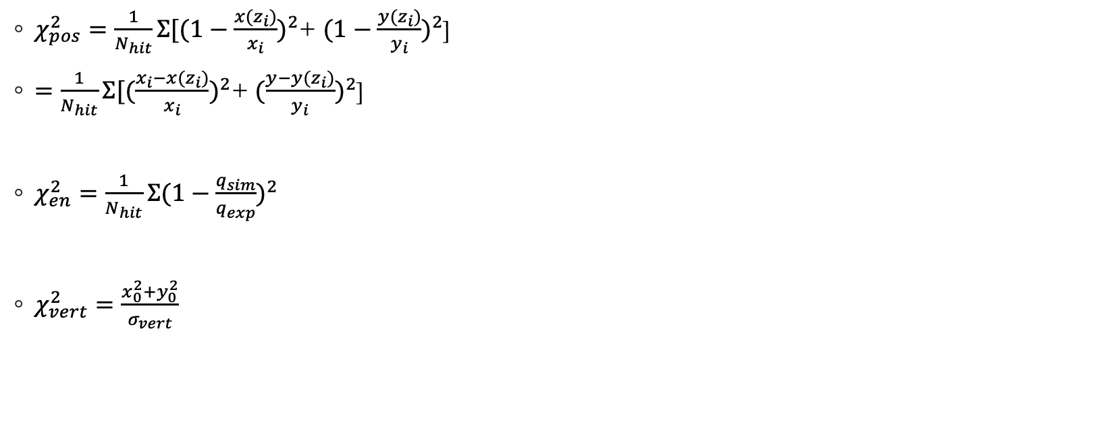
Monte-Carlo
$χ_{pos}^{2}=\frac{1}{N_{hit}}Σ[{(1−\frac{x(z_{i})}{x_{i}})}^{2}$+ ${(1−\frac{y(z_{i})}{y_{i}})}^{2}$]
$=\frac{1}{N_{hit}}Σ[{(\frac{x_{i}−x(z_{i})}{x_{i}})}^{2}$+ ${(\frac{y−y(z_{i})}{y_{i}})}^{2}$]
$χ_{en}^{2}=\frac{1}{N_{hit}}Σ{(1−\frac{q_{sim}}{q_{exp}})}^{2}$
$χ_{vert}^{2}=\frac{x_{0}^{2}+y_{0}^{2}}{σ_{vert}}$

Slide 4
Position chi function
Event simulation
Linear interpolation
Find position deviations between interpolated (simulated) x and y values and experimental x and y values corresponding to the same z values: (x-x0), (y-y0)
The pytpc script replaces NaN (resulting from interpolation out of range) with 100
Is it more accurate to look at only the non-NaN numbers?

Slide 5
Modified objective function
Position chi2 is much larger than energy

Slide 6
Trip to Hawaii
Meetings
TPC talks
Grad school talks
Poster session

Slide 7

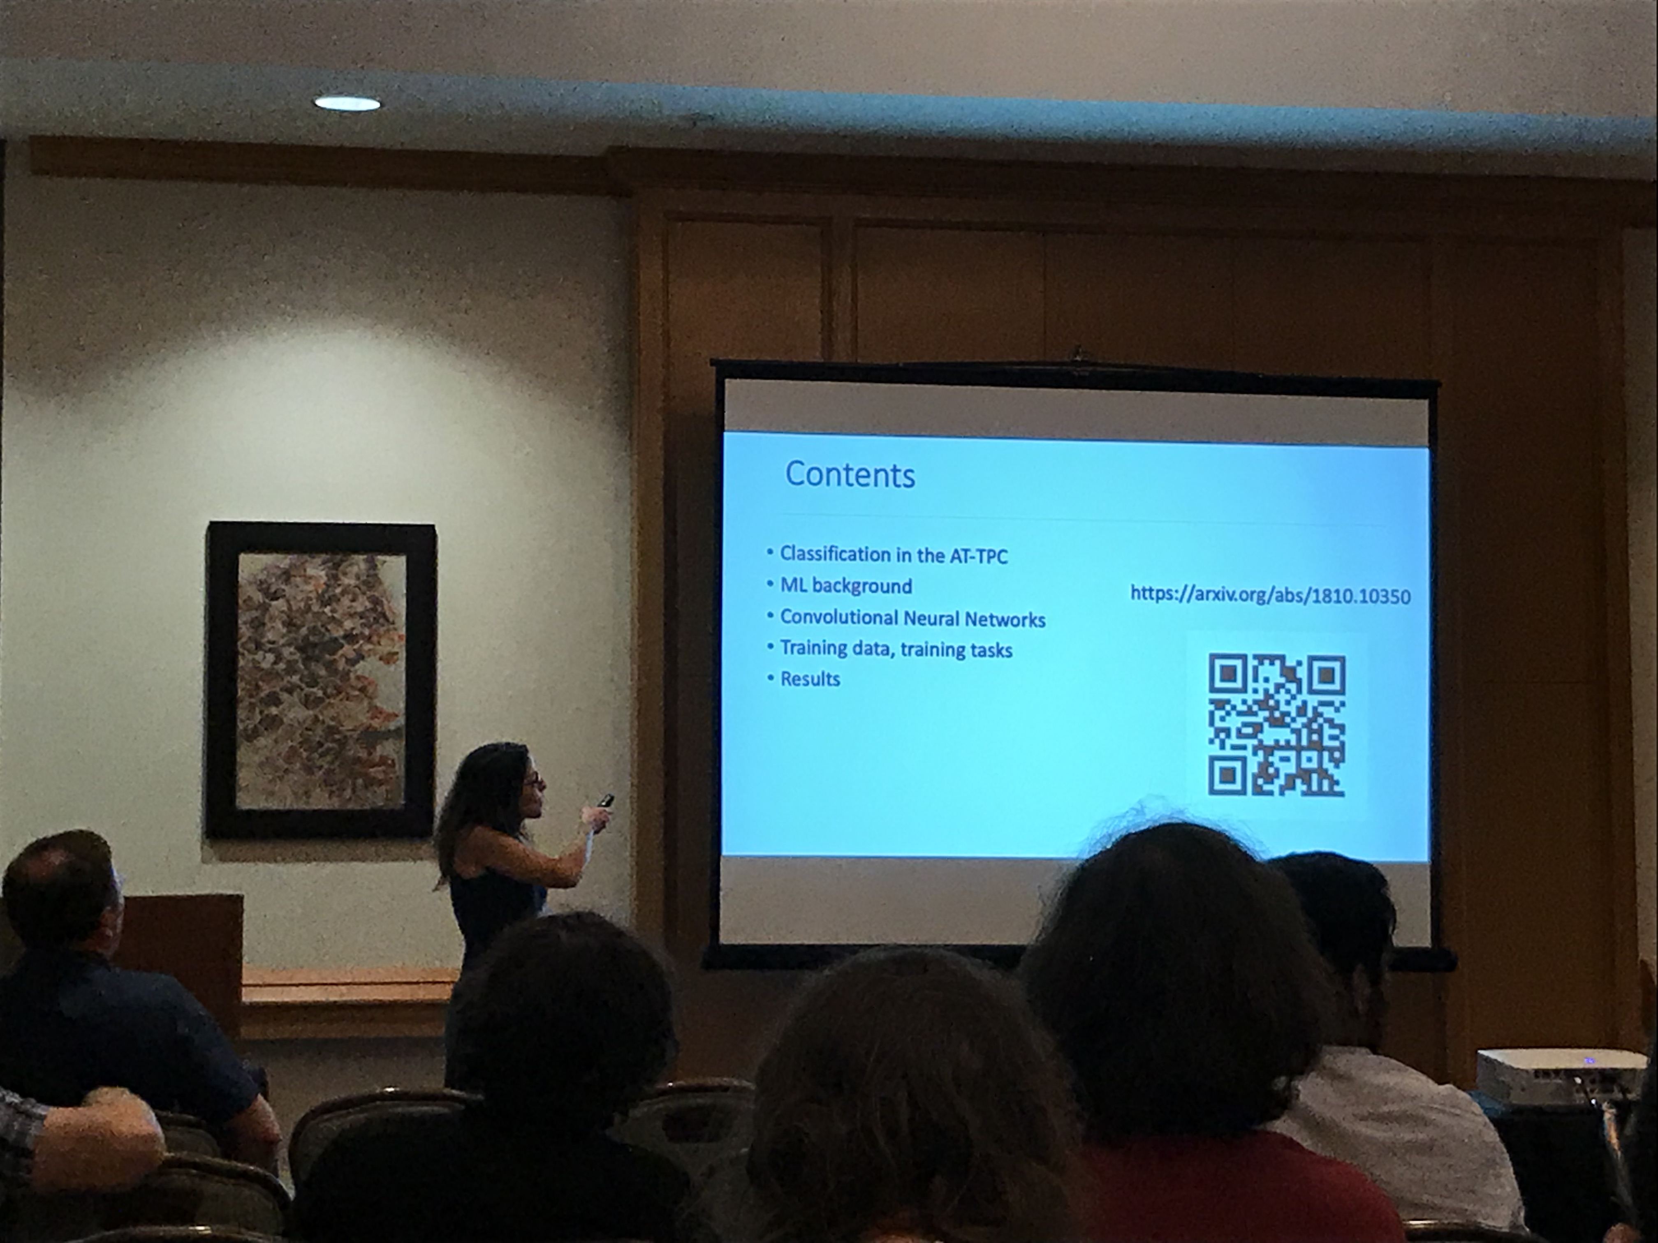



Slide 8




